Slide 1
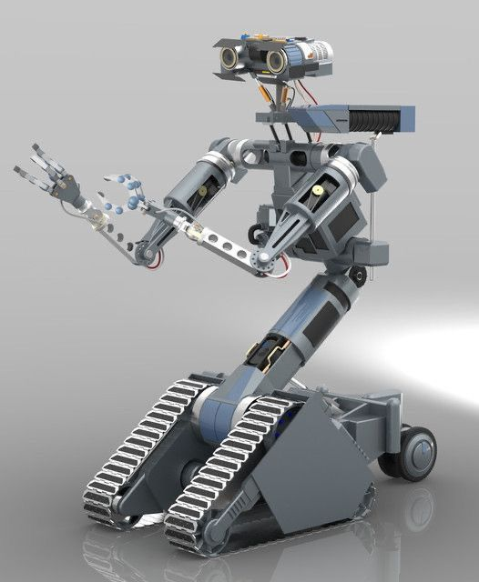
MODAR
Modular Adaptive Robotics
TEAM ALPHA MINDS

Slide 2

The Problem : Single Purpose, Infinite Waste
Rigid and Obsolete
Traditional robots are built for a single, narrow task, leading to rigidity
and rapid obsolescence.
High Cost of Entry
The specialization of traditional robotics translates to high purchase prices and massive long-term storage requirements for various dedicated devices.
Complexity
Traditional multi-task robotic systems require advanced programming and electronics knowledge, making them difficult for beginners to learn and experiment with.
E-Waste Epidemic
The single-purpose nature of these machines results in enormous volumes of electronic waste when they are replaced or retired.

Slide 3
The Solution: MODAR –
Modular Adaptive Robotics
Good Impacts of MODAR
Beginner-Friendly Learning
Easy for students and beginners to start experimenting with robotics. Hands-on experience without needing multiple specialized robots
One Core, Infinite Robotics
01
The Central Brain
A single core unit houses the primary processing
power and communication hub.
Scalability
New devices can be added easily..
02
Easy Interface
A simple, user-friendly interface makes it easy to connect any module to the robotic core. No complicated wiring or setup is needed.
Modularity
Each device has its own interface
but works under the same system.
03
Instant Adaptation
The system instantly detects new modules and
loads the correct configuration on the fly.
Intuitive Education
Turns robotics into an intuitive, interactive learning platform for schools and universities.

Slide 4




Advanced Operational Features
MODAR is engineered with next-generation features to maximize efficiency, safety, and user control in complex environments.
Autonomous Task Switching
Wireless Data Streaming
Wireless Reprogramming
Developer Friendly Environment
Use Cases and Deployment
MODAR’s inherent flexibility makes it uniquely suited for diverse sectors requiring rapid, on-demand robotic reconfiguration.
Education & Research
Industrial Applications
Autonomous Experiments

Slide 5
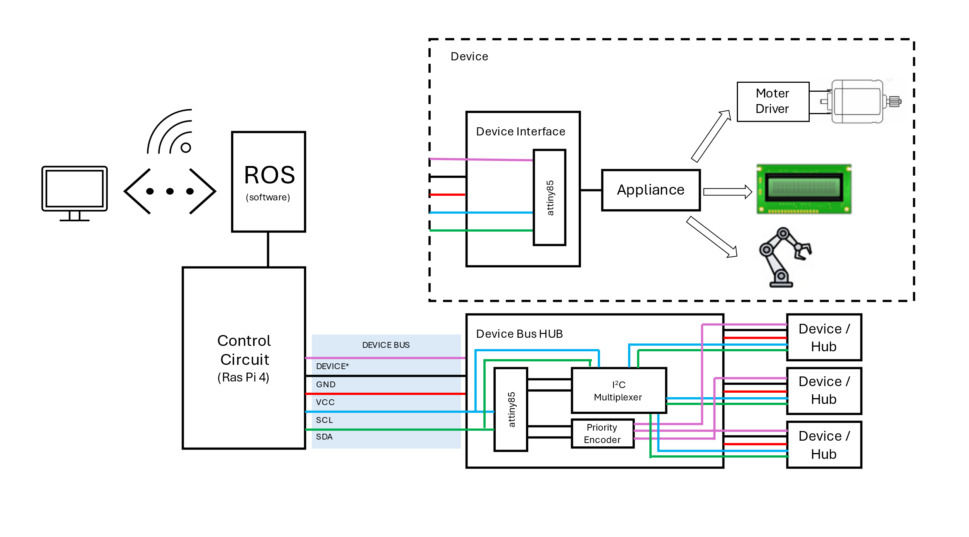
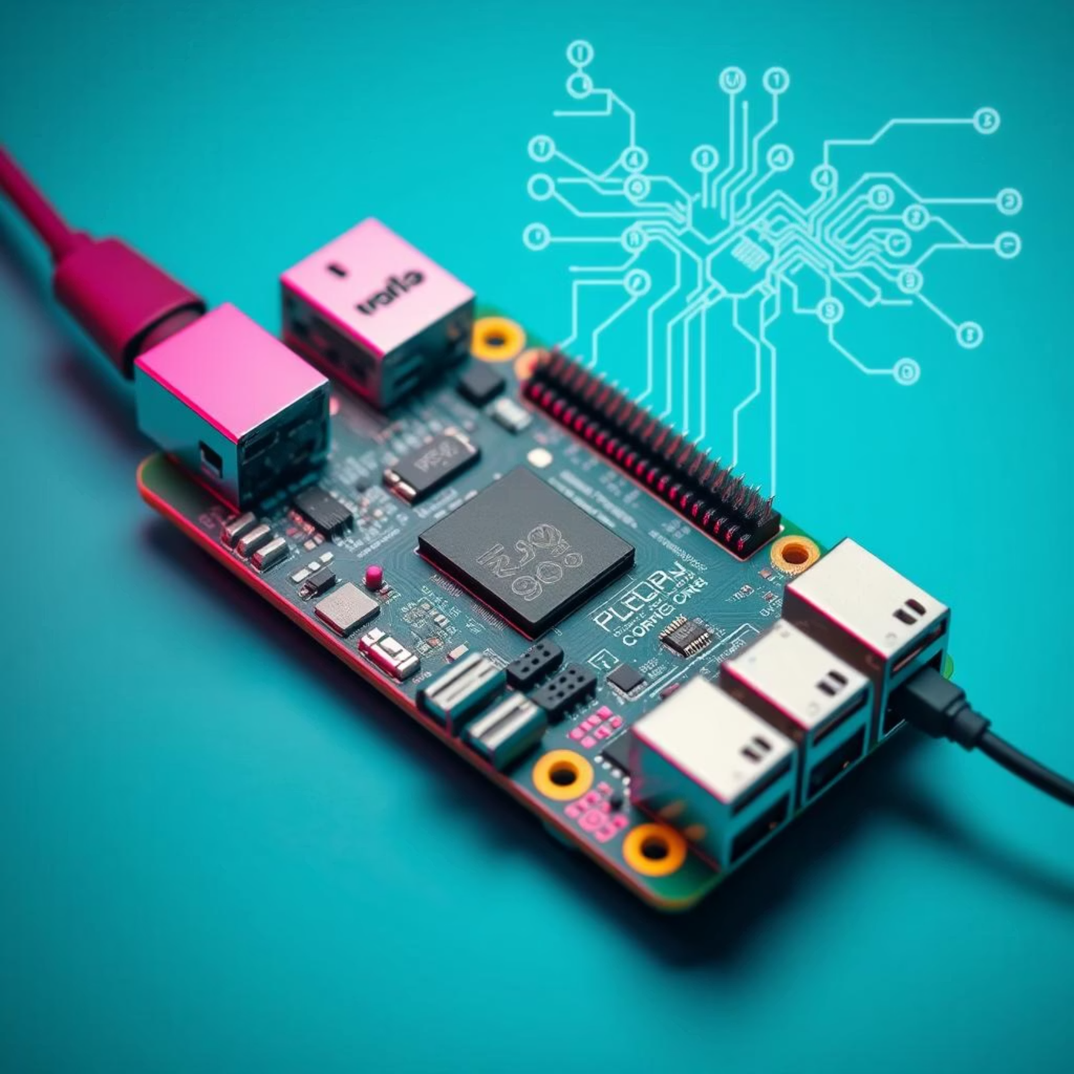
MODAR System Overview

Slide 6

Live Demonstration: MODAR in Action
Q & A

